Slide 1

Exo-Planet transit(Project 5)
Angelo O’Dorisio
Astro-1221

Slide 2



Agenda
Motivation
Methodology
Results
Conclusion

Slide 3
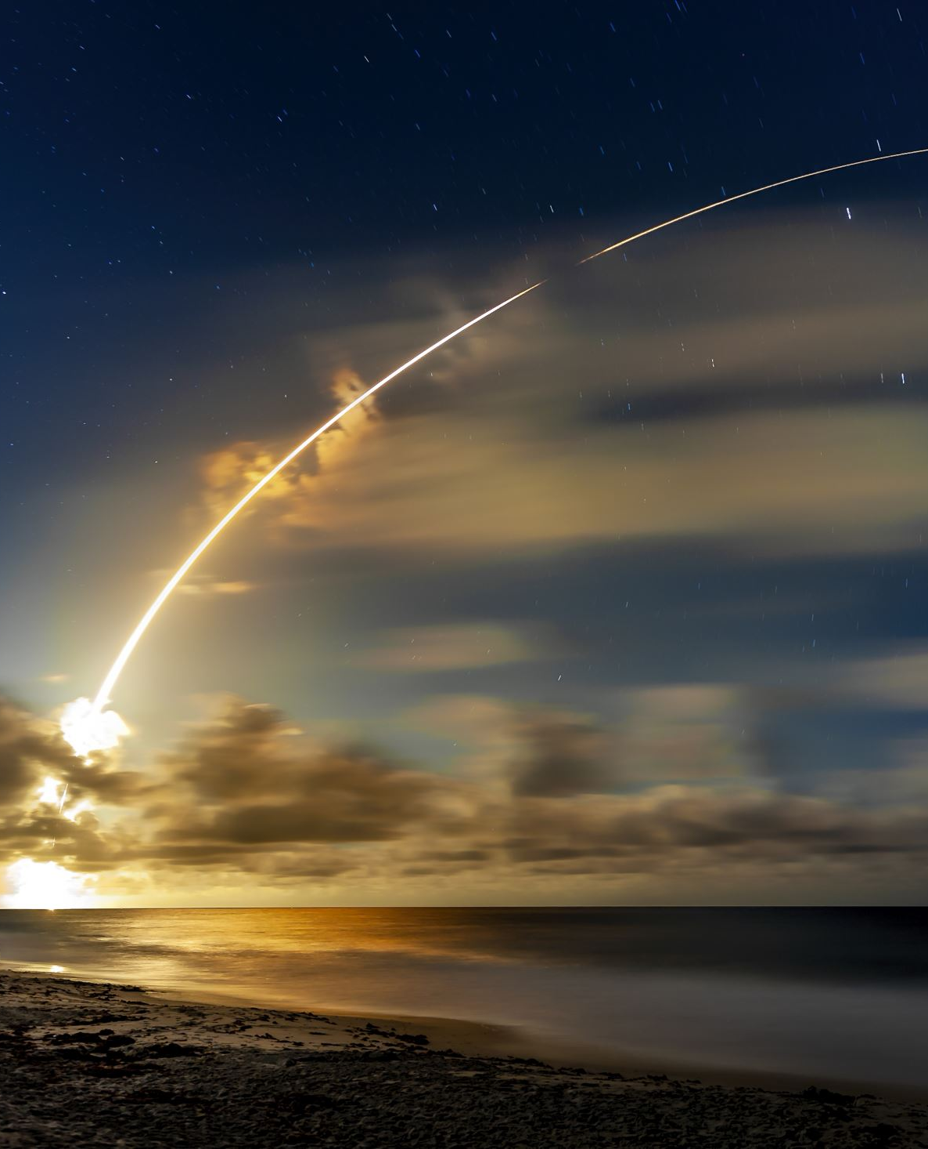

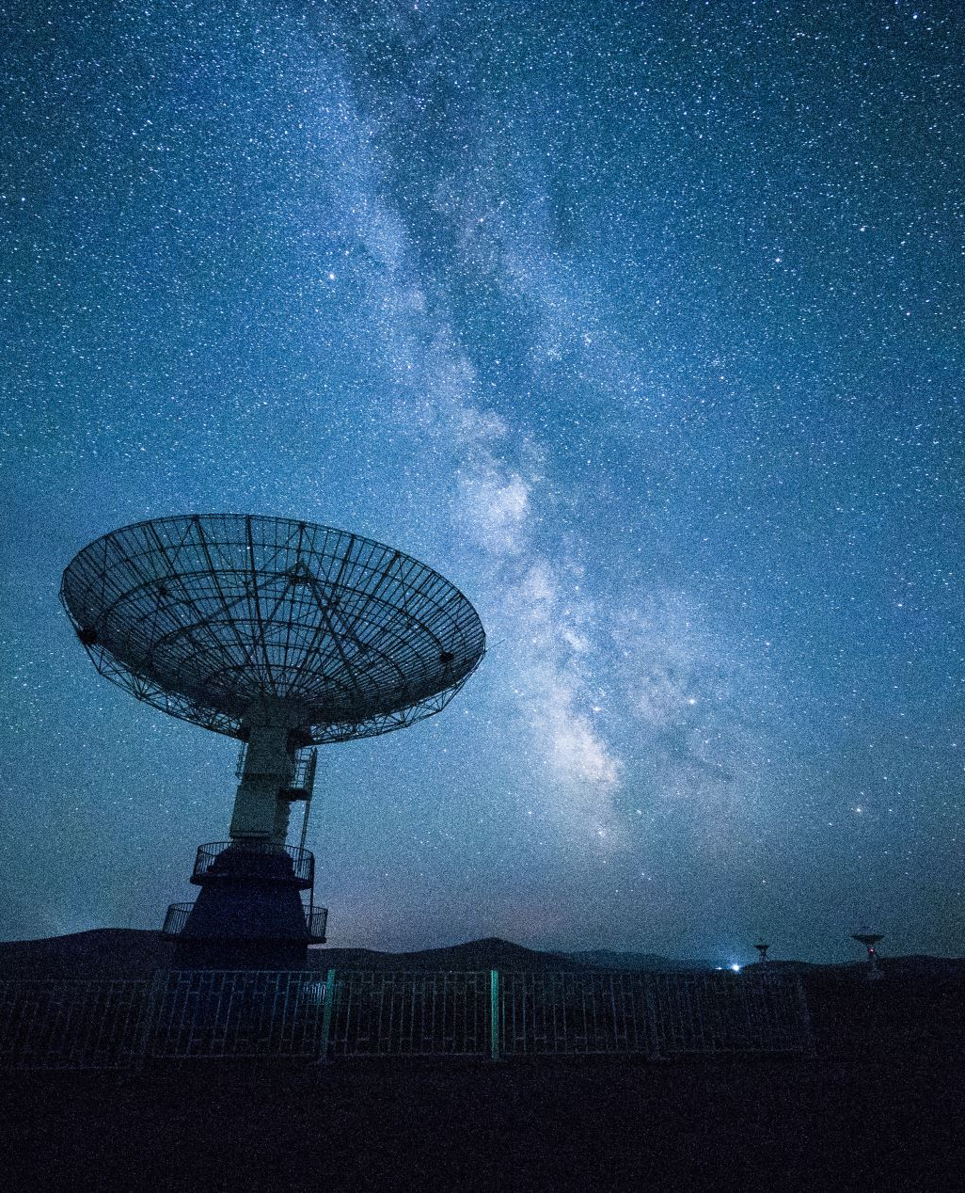

Motivation
As of recently we have been learning about exo-planet detection methods. We watched videos of how we have increased our understanding of exo-planets, along with reading papers that show us direct evidence through radial velocity, transit, and more. We focused mainly on transit, the method by which a planet is detected by observing blocked starlight. Which is of course caused from an exo-planet moving in front of the star. Data from these observations such as time in transit, and the amount of star-light which is blocked tell us more about the individual properties of these exo-planets.

Slide 4

Methodology
We used mainly a code that was given to us in class, we worked together in the code to discuss what each individual component meant. Adding and deleting parameters as we saw fit for our individual data set. The data sets we analyzed consisted of the flux, time, and real magnitude. These were specifically for a time that was before, during, and after a transit.

Slide 5
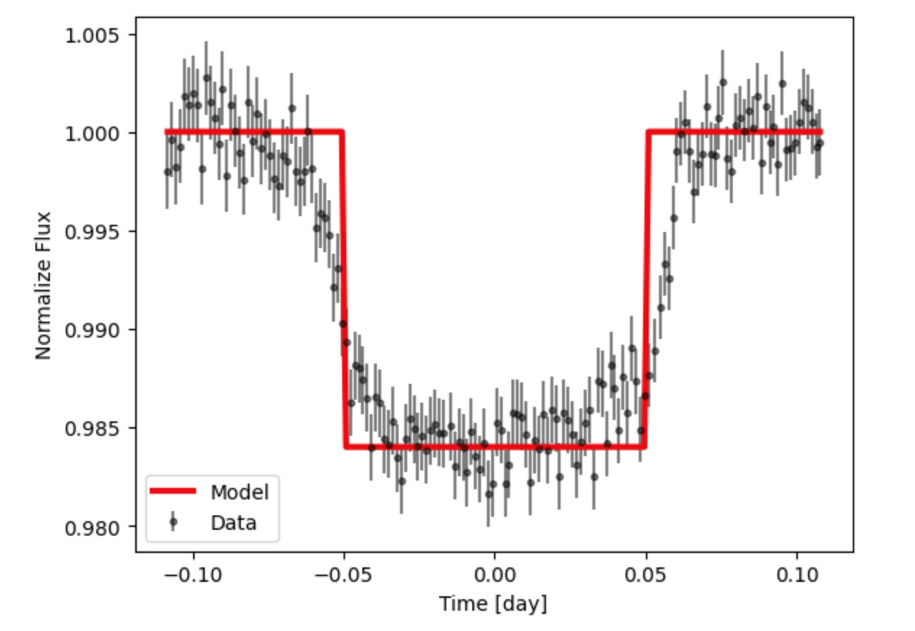
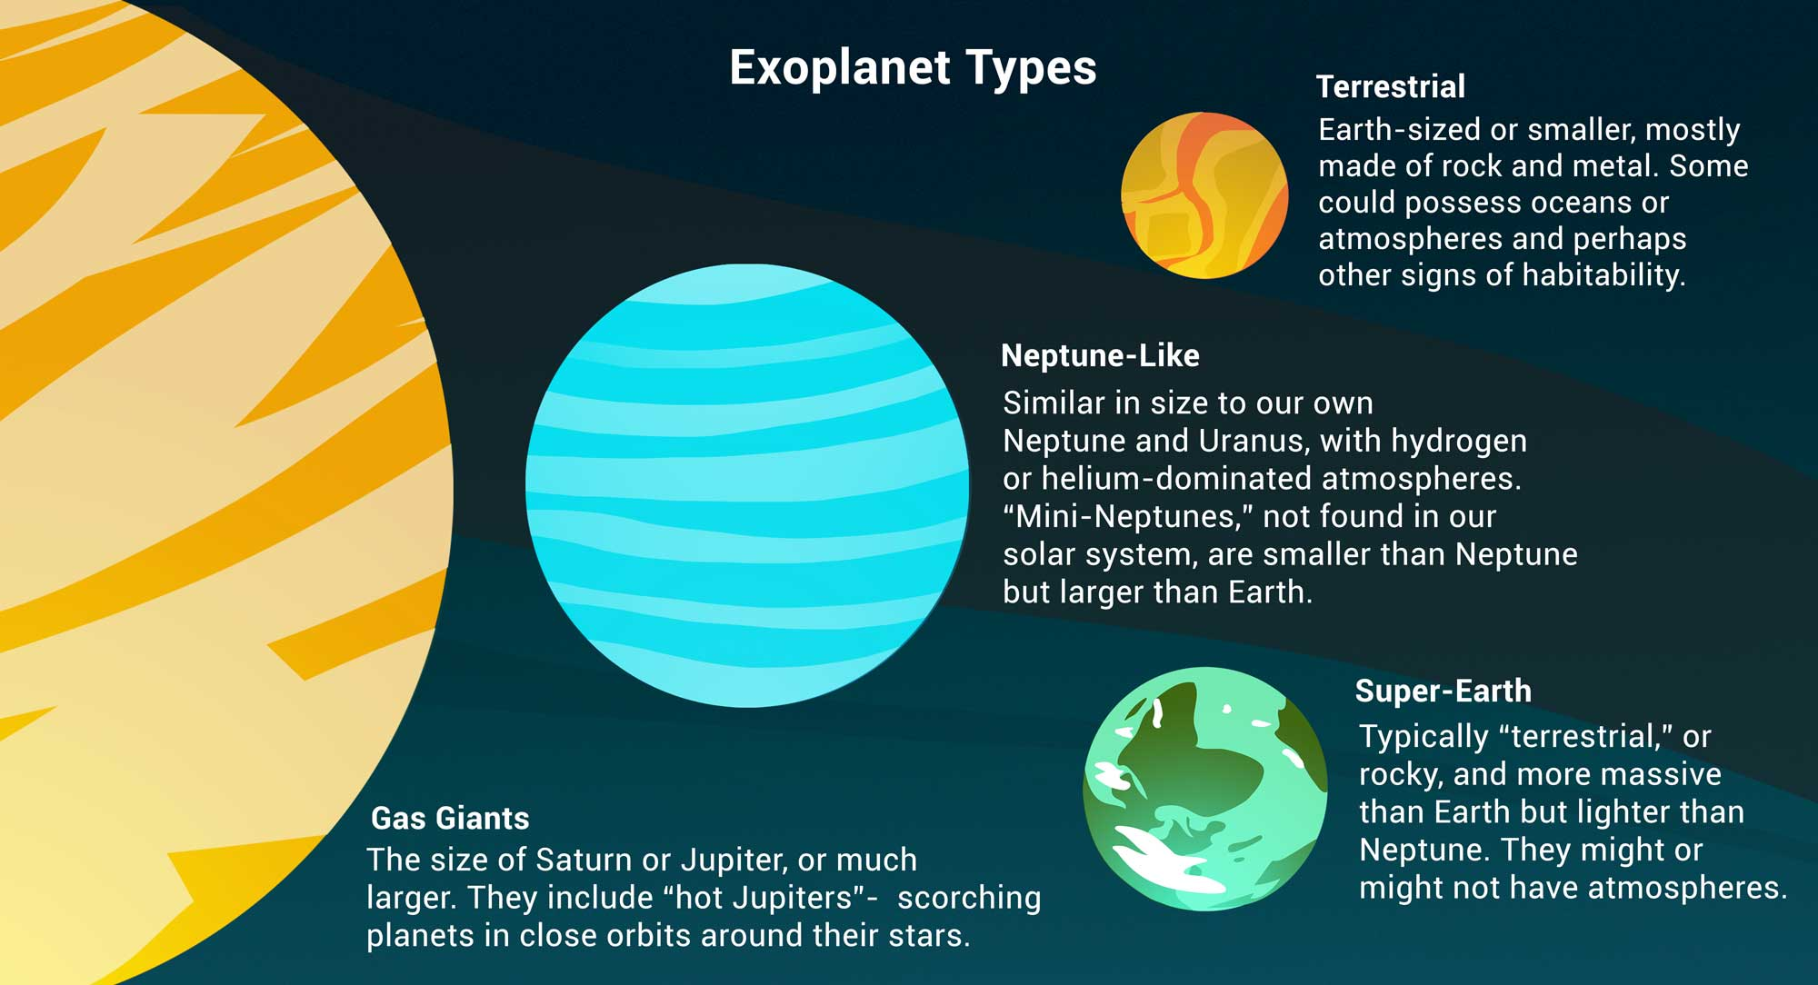

Slide 6
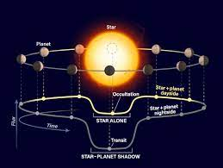
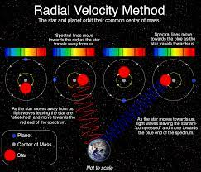
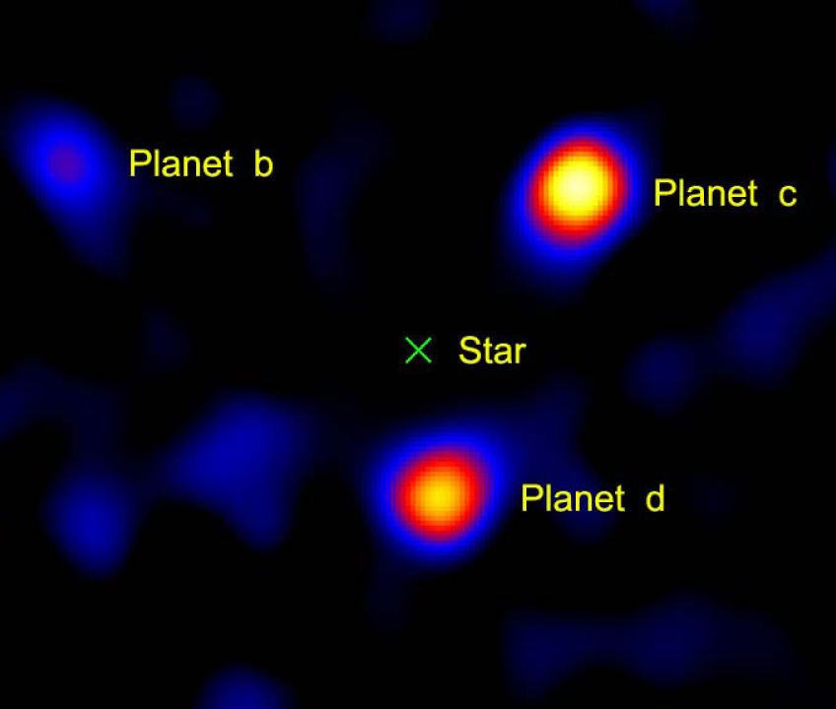

Observation techniques
Transit
Radial velocity
Direct imaging
Spectroscopy
Title
Title
Title

Slide 7

Data and Results
Through the data observed, a decrease in flux from the star is detected, it continues for a set period of time, implying a planet has passed in front of it. In this process it blocks a fraction of light heading our direction

Slide 8
Conclusion
In addition to reinforcing that transit data is a great way to evaluate exo-planetary orbits. We confirmed mathematically along with the NASA published data. That the radius of HD 209458b, is approximately 15.6 times that of the Earth. Our value calculated from code and raw data is on par with what NASA has, this is quite impressive (thanks for a great semester!)

